Slide 1
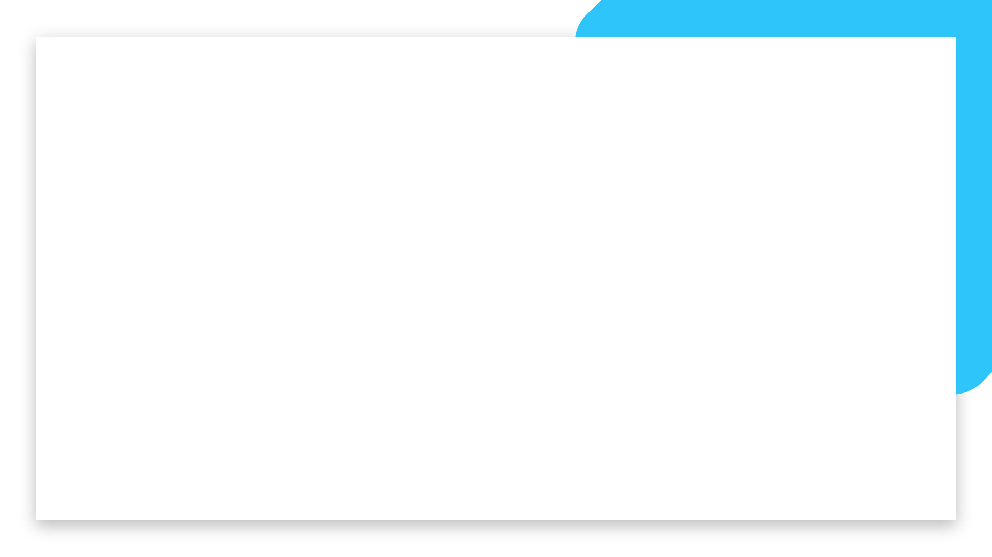


Data Analytics
Full-Time Bootcamp
NAÏVE BAYES CLASSIFIER

Slide 2
NAIVE BAYES - WHAT ABOUT THOSE PESKY CATEGORICALS?
Let’s say you have a table of registered voters in the USA, and the following features
Registered | Age group | Wealth | Education | Location
Democrat | Young | Middle Class | Higher | Urban
Independent | Middle Aged | Middle Class | Post Grad | Urban
Republican | Middle Aged | Rich | Post Grad | Rural
Democrat | Old | Middle Class | Higher | Rural
Republican | Middle Aged | Middle Class | Higher | Rural
Republican | Old | Poor | Basic | Rural
Democrat | Middle Aged | Middle Class | Post Grad | Urban
Democrat | Young | Poor | Basic | Urban
Independent | Old | Middle Class | Higher | Rural
You are interested in, given a non-registered voter for which you know the features, to understand how likely that voter is to vote Democrat, Republican or Independent.
This is not an exercise that you can do with a regression or even using classic statistics since you have no numeric variables whatsoever, so what can you do in this case?
Let’s suppose we get the following prospective voter features:
Age group | Wealth | Education | Location
Old | Middle Class | Post Grad | Rural

Slide 3
NAIVE BAYES
We could try to fit this voter with the majority of the voters that have exactly these features
But this has 2 problems
We may never have observed this exact combination of characteristics
We don’t want a “one rule” for all Old, Middle Class, Post Grad, Rural people. Some combinations are certainly more indicative of party affiliation than others
What we really would like is to be able to compare
Age group | Wealth | Education | Location
Old | Middle Class | Post Grad | Rural

Slide 4




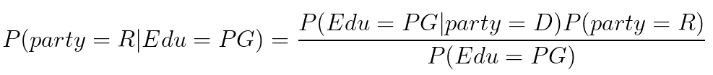
NAIVE BAYES - back to reality, simplified
Let’s try a simpler problem
In this case we could estimate this probability directly (see arrow) but let’s try a different approach.
Remember Bayes Rule?

Slide 5
NAIVE BAYES - back to reality, simplified
Now, if we are only interested in which of these is larger, we don’t care about the denominator
And we can estimate the right hand side parameters from our table… how?
The point here is that we can compute the probability of the party given the features from the probability of the features given the party...

Slide 6
NAIVE BAYES - back to the painful reality
But our problem is not this simple, let’s add back the other variables
What we will do is the same as in the simplified case: compute the probability of the party given the features from the probability of the features given the party
Technically, this requires us to assume that the features are independent from each other in the presence of the voting information, which we assume is more informative than any individual feature. This is the “Naive” assumption in Naive Bayes.

Slide 7

NAIVE BAYES - Don’t freak out!
Now this formula looks daunting, but don’t freak out yet
What are we really saying here?
The denominator is irrelevant because for the democrats we will have the same denominator. Since we are only interested in answering who has the higher probability, R’s or D’s, we don’t need to compute it.
The numerator has a bunch of factors, but they all look the same: what is the probability of being old given that one is republican? What is the probability of being middle class, given that one is republican? Etc etc. We can estimate all of these from our table!

Slide 8



NAIVE BAYES - Don’t freak out!
So in the end our rule
becomes
versus
We just need to compare these quantities to decide which is more likely. Notice we ignore the denominator because it is equal for both the democratic and the republican case.

Slide 9
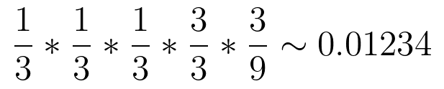
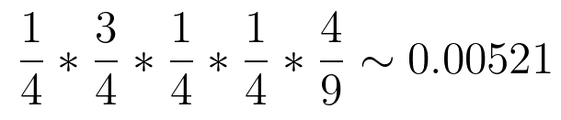
NAIVE BAYES - Who’s this guy after all?
Registered | Age group | Wealth | Education | Location
Democrat | Young | Middle Class | Higher | Urban
Independent | Middle Aged | Middle Class | Post Grad | Urban
Republican | Middle Aged | Rich | Post Grad | Rural
Democrat | Old | Middle Class | Higher | Rural
Republican | Middle Aged | Middle Class | Higher | Rural
Republican | Old | Poor | Basic | Rural
Democrat | Middle Aged | Middle Class | Post Grad | Urban
Democrat | Young | Poor | Basic | Urban
Independent | Old | Middle Class | Higher | Rural
Age group | Wealth | Education | Location
Old | Middle Class | Post Grad | Rural
Since 0.001234 > 0.00521, mystery guy is more likely to be a Republican than a Democrat

Slide 10

NAIVE BAYES - In short
So, if you have to decide between
For different a_i, you can instead compare
(which should be easy from your table of prior observations)
And take the a_i which makes this value largest.

Slide 11
TO THE COLLAB!

Slide 12
NAIVE BAYES - Issues
The independence assumption: we essentially double count features that are erroneously assumed independent
Zero-frequency problem: probability of said class automatically becomes 0 for said value. We can solve this by adding 1 to every single observation, but we need a somewhat large dataset to make this work.
Conditioning: as we get more and more features, our numbers become very tiny and computers may have trouble doing math with

Slide 14

NAIVE BAYES - what we would like to do
Now, it would be really awesome if
But if we think about it, we know this is very unrealistic: rural voters do not change from democrat to republicans as they age at the same rate as urban voters. The conditional probabilities are not independent at all.

Slide 15

NAIVE BAYES
But our problem is not this simple, let’s add back the other variables
From Baye’s rule…
And still from Baye’s rule
A
B
A
B
B

Slide 16
NAIVE BAYES
But our problem is not this simple, let’s add back the other variables
From Baye’s rule…
And still from Baye’s rule
A
B
A
B
B

Slide 17
NAIVE BAYES - the magic trick
Now the trick in Naive Bayes is the following claim: We assume that the information nonn how one votes

